Slide 1
PHYS4260 Quantum Mechanics II Spring 2025
Scattering Theory

Slide 2
Outline
Scattering Theory:
The Born Approximation: 1st order Born Approximation
Low energy scattering of soft spheres
Yukawa scattering
Rutherford scattering
Born series
Optical theorem

Slide 3
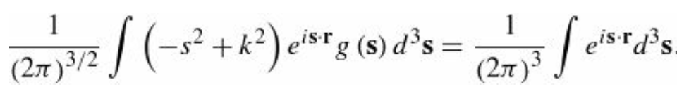
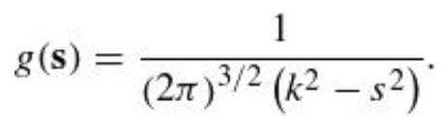
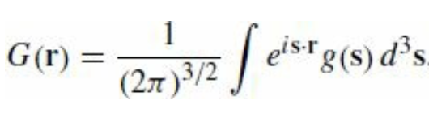
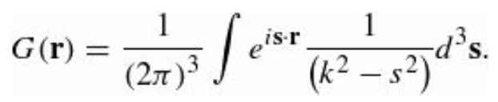
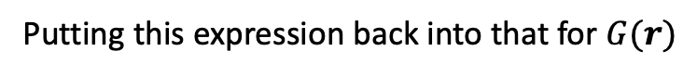
Re:The Born Approximation
Substituting this in the inhomogeneous Helmoltz equation
from which it follows that
Putting this expression back into that for $G(r)$
Now, r is fixed, as far as the s integration is concerned. At this point, we choose spherical coordinates.

Slide 4
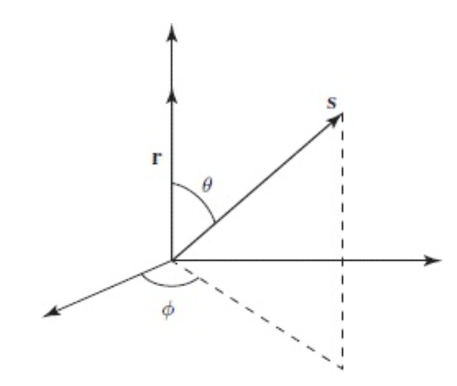
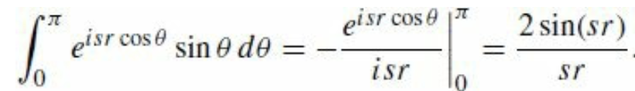
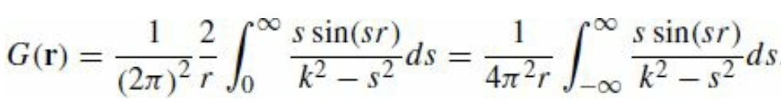
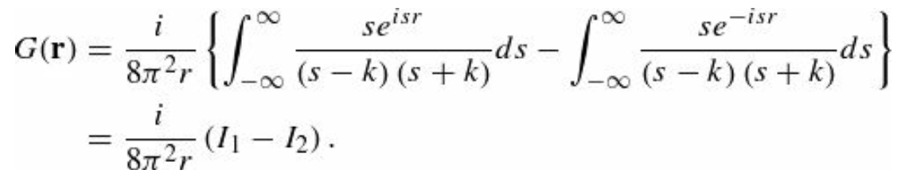
Re: The Born Approximation
But in this case the polar axis is aligned to r. The azimuthal integration is trivial and gives $2π,\text{the} \text{θ} \text{integral} \text{is}$
Thus,
The remaining integral is not so simple. It pays to revert to exponential notation, and factor the denominator:

Slide 5
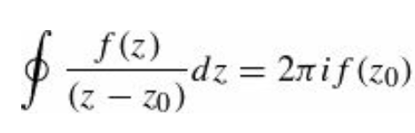
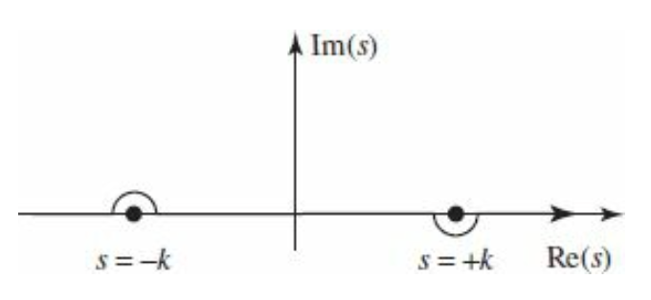
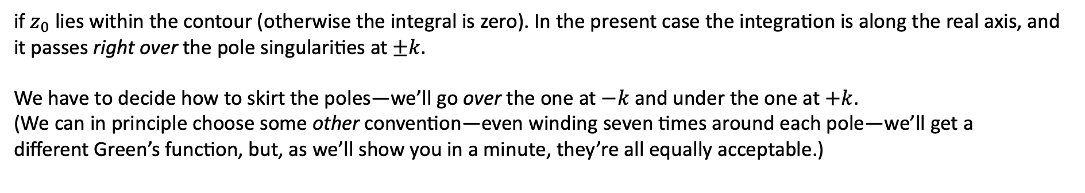
Re: The Born Approximation
These two integrals can be evaluated using Cauchy’s integral formula:
if $z_{0}$ lies within the contour (otherwise the integral is zero). In the present case the integration is along the real axis, and
it passes right over the pole singularities at $±k.$
We have to decide how to skirt the poles—we’ll go over the one at $−k$ and under the one at $+k$.
(We can in principle choose some other convention—even winding seven times around each pole—we’ll get a
different Green’s function, but, as we’ll show you in a minute, they’re all equally acceptable.)
For each integral in our equation, we must “close the contour” in such a way that the semicircle at infinity contributes nothing (Jordan’s Lemma in complex analysis).

Slide 6
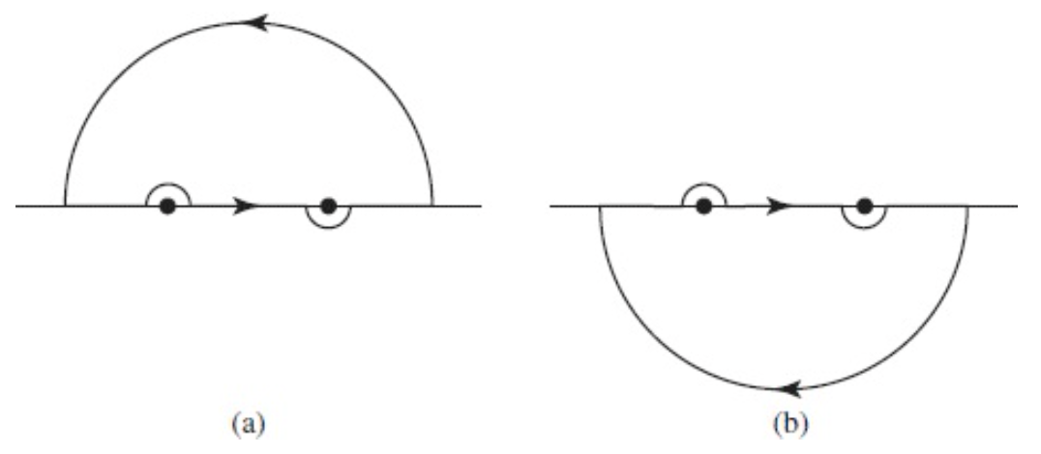
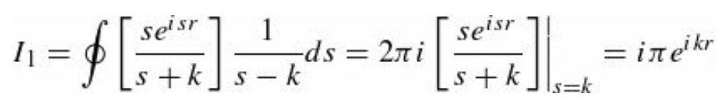
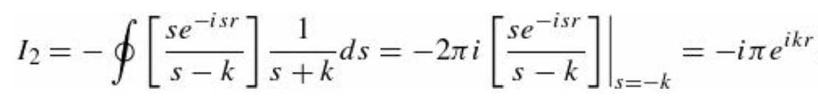
The Born Approximation
In the case of $I_{1}$ the factor $e^{isr}$ goes to zero when s has a large positive imaginary part; for this one we close above
(see Fig. a). The contour encloses only the singularity at $s=+k$
In the case of $I_{2}$ the factor $e^{−isr}$ goes to zero when s has a large negative imaginary part; for this one we close below
(see Fig. b). This time the contour encloses only the singularity at $s=−k$ (and it goes around in the clockwise direction,
so we pick up a minus sign):

Slide 7
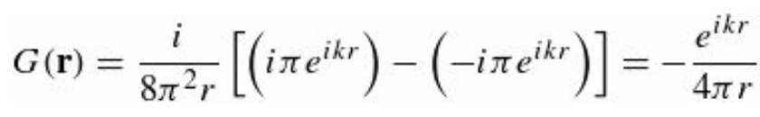
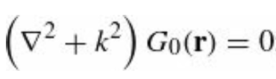
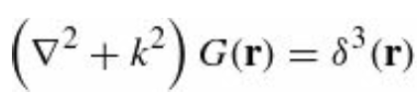
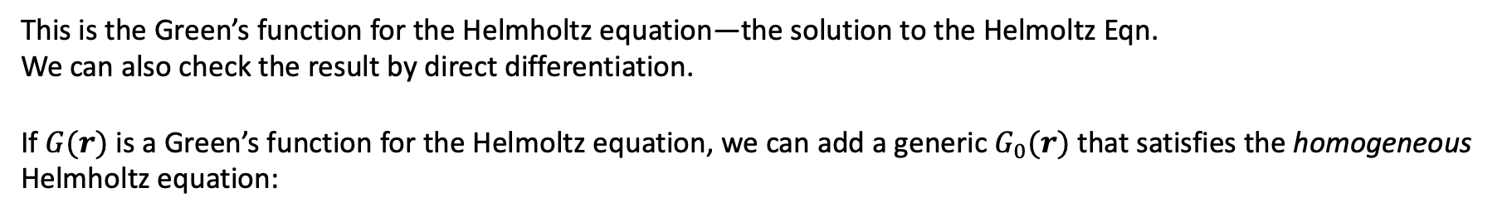

The Born Approximation
In conclusion, we obtain
This is the Green’s function for the Helmholtz equation—the solution to the Helmoltz Eqn.
We can also check the result by direct differentiation.
If $G(r)$ is a Green’s function for the Helmoltz equation, we can add a generic $G_{0}(r)$ that satisfies the homogeneous
Helmholtz equation:
Clearly, $G\left(r\right)+G_{0}(r)$ is still a solution of
This ambiguity corresponds precisely to the ambiguity in how to skirt the poles—a different choice amounts to picking
a different function $G_{0}\left(r\right).$

Slide 8
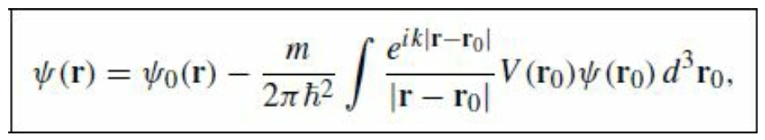
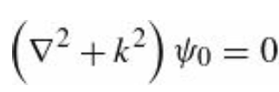
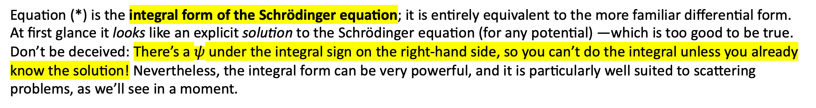
The Born Approximation
The general solution to the Schrödinger equation takes the form
(*)
Where $ψ_{0}$ satisfies the free particle Schrödinger equation
Equation (*) is the integral form of the Schrödinger equation; it is entirely equivalent to the more familiar differential form.
At first glance it looks like an explicit solution to the Schrödinger equation (for any potential) —which is too good to be true.
Don’t be deceived: There’s a $ψ$ under the integral sign on the right-hand side, so you can’t do the integral unless you already
know the solution! Nevertheless, the integral form can be very powerful, and it is particularly well suited to scattering
problems, as we’ll see in a moment.

Slide 9
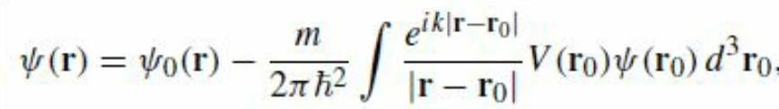
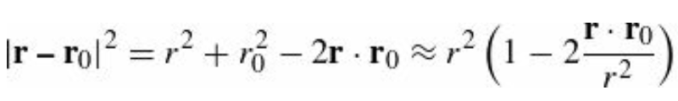
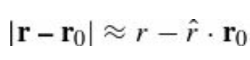
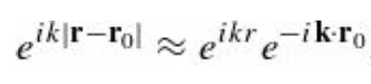
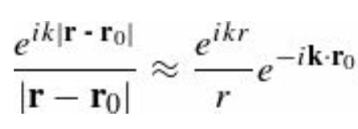
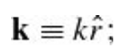
The first Born approximation
Suppose $V(r_{0})$ is localized about $r_{0}=0,$ that is, the potential drops to zero outside some finite region (as is typical for a
scattering problem), and we want to calculate $ψ(r)$ at points far away from the scattering center.
Then, $\left|r\right|≫r_{0}$ for all points that contribute to the integral
Therefore, we have
If we let
then
and
Note that in the denominator we can afford to make the more radical approximation $|r−r_{0}|≈r$ while in the exponent we need to keep the next term. What we are doing is expanding in powers of the small quantity $r_{0}/r$ and dropping all but the lowest order.

Slide 10
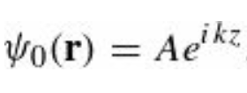
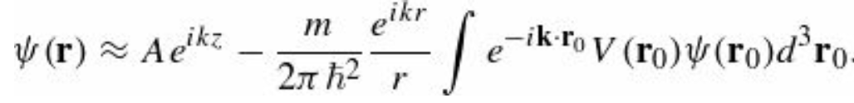
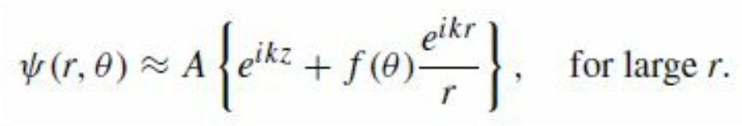
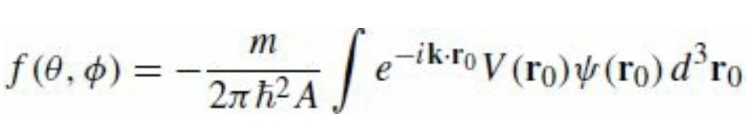
The first Born approximation
In the case of $V(r) = 0$ scattering, we want
representing an incident plane wave. For large r, then,
This is in the standard form
and we can read off the scattering amplitude

Slide 11
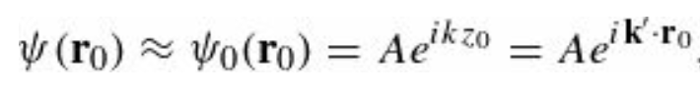
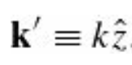
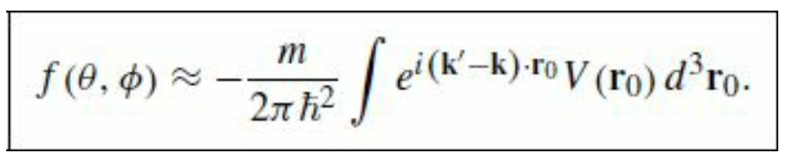
The first Born approximation
The previous equation is exact. Now we invoke the Born approximation: Suppose the incoming plane wave is not substantially altered by the potential; then it makes sense to use
where
inside the integral. (This would be the exact wave function, if V were zero; it is essentially a weak potential approximation.) In the Born approximation, then,

Slide 12
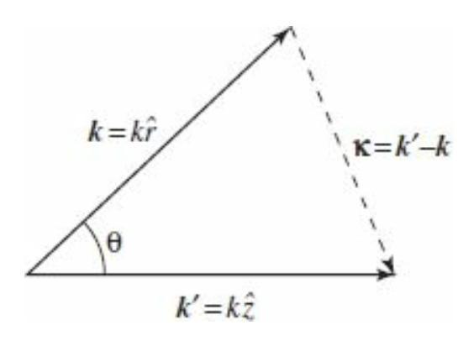
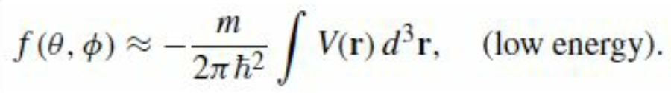
The first Born approximation
$k$ and $k′$both have magnitude k, but the former points in the direction of the incident beam, while the latter points toward the detector—see Figure; $ℏ(k−k′)$ is the momentum transfer in the process.)
In particular, for low energy (long wavelength) scattering, the exponential factor is essentially constant over the scattering region, and the Born approximation simplifies to
(Note that we dropped the 0 subscript on r, since there is no likelihood of confusion at this point.)

Slide 13
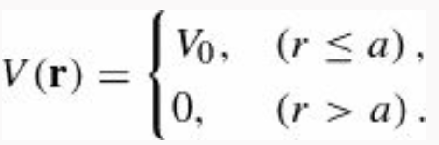
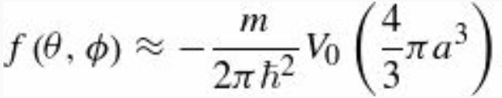
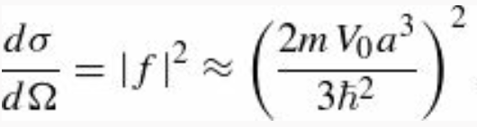
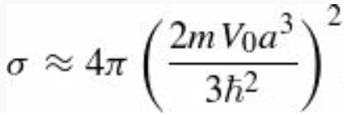
Example 10.4 Low-energy soft-sphere scattering
Let’s assume now that the potential is not $∞$ for $r≤a$ (soft sphere)
In this case the low-energy scattering amplitude is
(independent of θ and φ), the differential cross-section is
and the total cross-section is

Slide 14
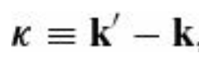
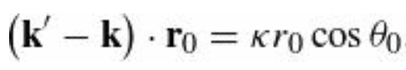
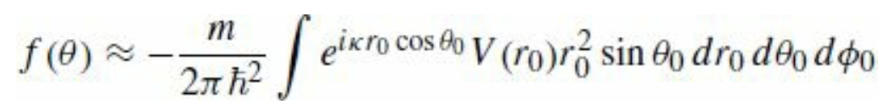
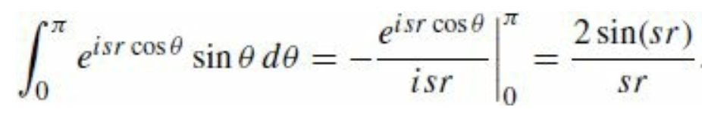
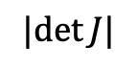
The first Born approximation
For a spherically symmetrical potential, $V\left(r\right)=V\left(r\right)$, but not necessarily at low energy, the Born approximation again reduces to a simpler form. We define vector kappa
and let the polar axis for the $r_{0}$ integral lie along $κ$ so that the $θ_{0}$ angle is between $κ$ and $r_{0}$
Then
$$|det⁡J|$$
The $φ_{0}$ integral gives $2π$, and the $θ_{0}$ integral is one we have encountered before

Slide 15
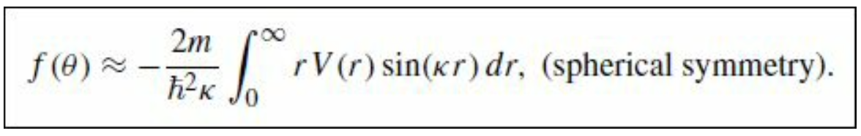
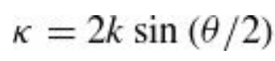
The first Born approximation
Dropping the subscript on r, we are left with
The angular dependence of f is carried by κ; in the Figure we see that
At this point, we need to know the potential.

Slide 16
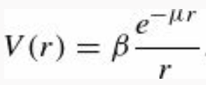
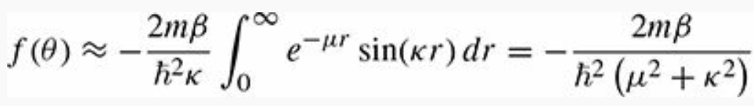



Example 10.5: Yukawa scattering
The Yukawa potential (which is a crude model for the binding force in an atomic nucleus) has the form
where β and μ are constants. The Born approximation gives
To solve this integral we observe that
And we obtain

Slide 17






Example 10.6: Rutherford scattering
If we put in
then the Yukawa potential reduces to the Coulomb potential, describing the electrical interaction of two point-like charges.
Evidently the scattering amplitude is
Using
and
Is precisely the Rutherford formula.
It happens that for the Coulomb potential classical mechanics, the Born approximation, and quantum field theory all yield the same result. The Rutherford formula is amazingly “robust.”
The differential cross-section is the square of this:

Slide 18



The Born Series
The Born approximation is similar in spirit to the impulse approximation in classical scattering theory. In the impulse approximation we begin by pretending that the particle keeps going in a straight line (see Figure), and compute the transverse impulse that would be delivered to it in that case:
transverse impulse
If the deflection is relatively small, this should be a good approximation to the transverse momentum imparted to the particle, and hence the scattering angle is
where p is the incident momentum. This is, the “first-order” impulse approximation (the zeroth- order is what we started with: no deflection at all). Likewise, in the zeroth-order Born approximation the incident plane wave passes by with no modification, and what we explored in the previous discussion is really the first-order correction to this. But the same idea can be iterated to generate a series of higher-order corrections, which presumably converge to the exact answer.

Slide 19




The Born Series
The integral form of the Schrödinger equation reads
where $ψ_{0}$ represents the incident wave, and the Green’s function (into which we have now incorporated the factor $2m/ℏ^{2}$
and V is scattering potential. Schematically,
Suppose we take this expression for $ψ$ and plug it in under the integral sign:

Slide 20


The Born Series
Iterating this procedure, we obtain a formal series for $ψ$
In each integrand only the incident wave function $ψ_{0}$ appears, together with more and more powers of $gV$.
The first Born approximation truncates the series after the second term, but it is pretty clear how one generates the higher-order corrections. The Born series can be represented diagrammatically as
0-th order: $ψ$is untouched by the potential;
1-th order: $ψ$ is “kicked” once, and then “propagates” out in some new direction;
2-nd order: $ψ$ is kicked, propagates to a new location, is kicked again, and then propagates out; and so on
In this context the Green’s function is sometimes called the propagator—it tells you how the disturbance propagates between one interaction and the next.

Slide 21



The Born Series
The Born series was the inspiration for Feynman’s formulation of relativistic quantum mechanics, which is expressed entirely in terms of vertex factors $V$ and propagators $g$ connected together in Feynman diagrams.

Slide 22






The Optical Theorem
The optical theorem, relates the total cross-section to the imaginary part of the forward scattering amplitude:
From partial wave analysis we learned that
The total cross section
In terms of phase shifts

Slide 23





The Optical Theorem
The Legendre polynomials satisfy $P_{l}\left(1\right)=1$. This means that when $θ→0$
$$→$$
This results in
In physics, the optical theorem is a general law of wave scattering theory, which relates the zero-angle scattering amplitude to the total cross section of the scatterer.

